Slide 1
How Does Screen Time Impact Children?
By Kelsey Dean and Carina Funk

Slide 2
Positive Effects
Children are now being raised in a new time where technology is more integrated than ever before.
Technology and screens are motivating in the eyes of children. Children observe their parents and other peers using technology, and they want to mimic their parents and do the same.

Slide 3
Positive Effects
By integrating technology, it teaches skills that will be applicable in their lifetime, as well as it prepares them with knowledge of how to work technology.
In today’s society, screen time and learning technology is now a basic requirement.

Slide 4
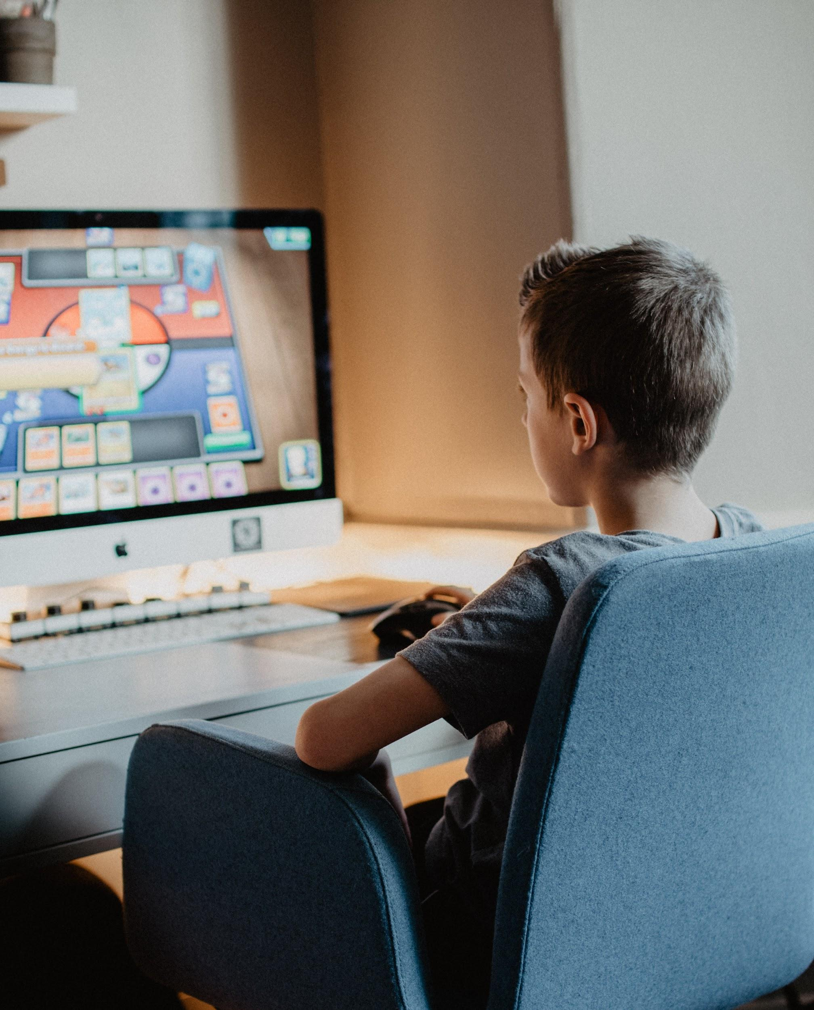
Positive Effects
Schools are widely incorporating technology - they believe that students are learning better.
Children are exposed to lots of unique learning through technology in the classroom, more than students before them.
Even if they don't like the subject, they are still motivated to use the technology platform.

Slide 5
Positive Effects
It allows for the expansion of communication and family bonding
Access to “face to face” connections over long distance through video call, individuals can now recognize facial gestures over the phone.

Slide 6
Sleep
Blue light can also decrease the amount of REM sleep and slow wave sleep that we experience (2 important sleep stages for cognitive processes)
Screens emit blue light, which decreases the body’s secretion of melatonin; therefore, making it more difficult to fall asleep at night

Slide 7
Sleep
Screen time affects the quality of one’s sleep
The body secretes melatonin (a hormone that increases the feeling of sleepiness) in the evening

Slide 8
Mental Health
The overuse of screen time, and time spent online has shown links to harmful to family relationships. One in three children feel unimportant when their parents are focused on their phones.
“Even replying to a quick text message could be sending your child another message—that your phone is more important than [they are]”.

Slide 9
Mental Health
This could lead to a more likely chance that the child will develop mental health issues in the future, including depression.
Increased time spent playing video and computer games can often lead to increased risk for health problems such as ADHD.
ADHD can make it more difficult for children to have self control with video games possibly leading to addiction later in life.

Slide 10
Mental Health
With many of these children online and connected to social media, we can see that it strongly affects body image.
For children ages six to eight, half of girls and a third of boys, say that their ideal body image is to be thinner.
Surprisingly, one third of children ages five and six, indicate that they feel the same - that they wish to be thinner.

Slide 11
Communication and Social Interactions
It is important for children to experience two-way interactions when learning
They need to experience facial expressions and reactions when communicating
This is important in language and skill development

Slide 12
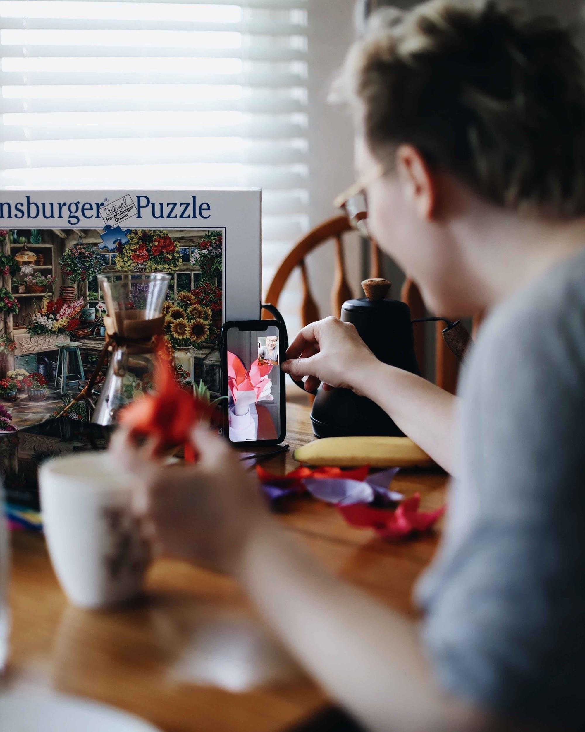
Communication and Social Interactions
When children learn from screens using resources such as videos, they do not have that full experience that they need for their skill and language development

Slide 13
Digital Detox
Digital Detox means unplugging from your devices for short periods of time, on a short term basis.
It is often recommended for families who have a difficult time breaking habits in regards to technology.
It can increase social and emotional issues, reversing the effects of screen time.
With a constant change in technology, you can see how children respond to screen time and technology.

Slide 14
Digital Detox
In today’s age, everything is portable and can be taken everywhere, which often means that there is a decrease in time spent face to face.
Face to face time is important in the development of children's social skills, and it can help with learning non verbal cues.

Slide 15
Digital Detox
Signs you should consider a digital detox:
Children are becoming reliant on their technology, for entertainment.
There is now a power struggle between the parent and the technology.
Bad habits are being formed from technology eg. checking your phone constantly.

Slide 16
Digital Detox
Strategies:
A week long break.
Electronics free weekend.
A monthly digital free day.
Replace screen time with outdoor time.

Slide 17
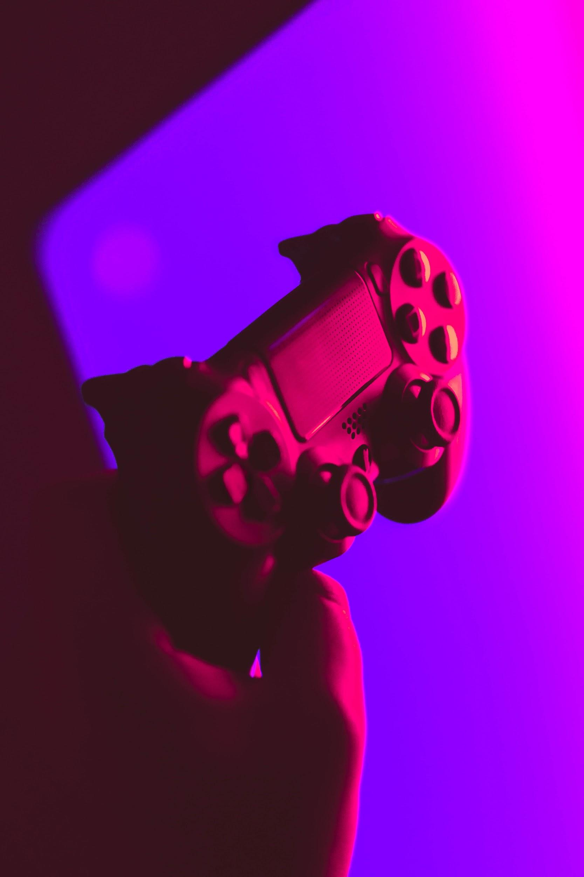
Physical Health: Obesity
Children from ages 4 to 9 who experience more than 1.5 hours of screen time per day are more likely to become obese
This is because of the extended time period that they are sitting and watching a screen rather than being active

Slide 18
Physical Health: Obesity
Unhealthy food shown in TV shows and advertisements can lead children to crave junk food and overeat, possibly leading to obesity
Some children snack excessively while watching a screen, which is another factor of obesity

Slide 19
Bibliography
Cross, Jennifer F. “What Does Too Much Screen Time Do to Kids' Brains?” NewYork-Presbyterian, 5 Oct. 2020, healthmatters.nyp.org/what-does-too-much-screen-time-do-to-childrens-brains/.
Dutta, Sanchari Sinha. “Does Screen Time Affect Children's Development?” News, 14 Apr. 2020, www.news-medical.net/health/Does-Screen-Time-Affect-Childrene28099s-Development.aspx.
Pacheco, Danielle. “Can Electronics Affect Quality Sleep?” Sleep Foundation, 7 Nov. 2020, www.sleepfoundation.org/articles/why-electronics-may-stimulate-you-bed.
Robidoux, Hannah, et al. “Screen Time: The Impact of Digital Technology on Children and Strategies in Care.” Journal of Psychosocial Nursing and Mental Health Services, vol. 57, no. 11, 2019, pp. 15–20., www-healio-com.ezproxy.library.uvic.ca/psychiatry/journals/jpn/2019-11-57-11/%7B0b937679-d32b-4392-b9c2-6b826f0eca4c%7D/screen-time-the-impact-of-digital-technology-on-children-and-strategies-in-care.
Morin, Amy. “How a Digital Detox Could Improve Your Child's Behavior Problems”. Verywell Family. Forman, Joe. April 22, 2020. https://www.verywellfamily.com/digital-detox-to-solve-kids-behavior-problems-4087711
Morin, Amy. “How Too Much Screen Time Can Hurt Kids and Their Families”.Verywell Family. Lockhart, Ann-Louise T. September 17, 2020. https://www.verywellfamily.com/the-negative-effects-of-too-much-screen-time-1094877
Bidwell, Jeremy. “The Effects of Screen Time on Children”. Psych Central. April 12, 2019. https://psychcentral.com/lib/the-effects-of-screen-time-on-children/
(pictures from: https://unsplash.com)

